Slide 1
Souther Machinery 2023 Catalog
Southern Machinery 2023 Catalog:
1. Auto insertion solution 01
2. Auto mounting solution 05
3. Production line peripheral equipment solutions 09
4. Accessories 15
5. Services 19
6. About us 20
*Support customized solutions.
*To provide professional solutions of AI/SMT and SMT peripheral equipment and machine accessories.

Slide 2
Souther Machinery 2023 Catalog
S3010A
Radial Component
Solutions
Auto insertion solution
S4000
Axial Component
Solutions
S7020
Oddform Component
Solutions
01

Slide 3
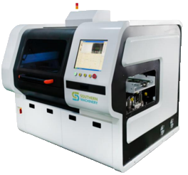
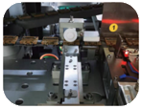
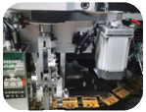
Souther Machinery 2023 Catalog
S3010A
Component Range:
Resistor Capacitor
Ceramic Capacitor
Film Capacitor
Floating Resistance
LED
Fully automatic insertion
Triode
Filter
Connector
Resistor Network
Resistance
Wide range of applications, can insert 20 kinds of components at the same time.
Easy programming
Easy operate(1 person can operate 4 machines at the same time)
Dimension: 1700X1600X1800mm
PCB size: 400X380mm
Component span: 2.5/3/3.5/5/7.5/10/15mm
Efficiency = 12000CPH(with Clinch) ≥ 8-10 workers
Video Link: https://youtu.be/Y6v_U97S_Ho
02

Slide 4
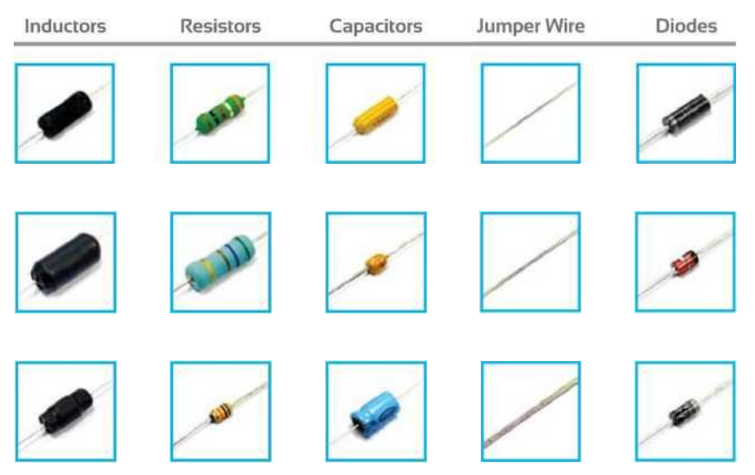
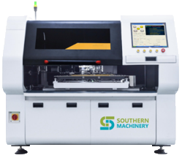
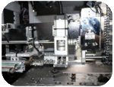
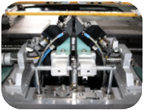
Souther Machinery 2023 Catalog
S4000
Component Range:
Can be insertioned in various angles
Wide range of applications, can insert 20 kinds of components at the same time.
Easy programming
Easy operate(1 person can operate 4 machines at the same time)
Dimension: 1700X1500X1800mm
PCB size: 320X360mm
Component span: 5-20mm
Efficiency = 13000CPH(with Clinch) ≥ 10 workers
Video Link: https://youtu.be/1YGdj1jnDOY
03

Slide 5
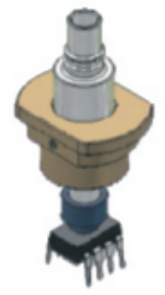
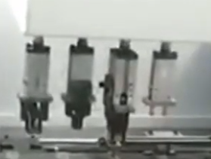
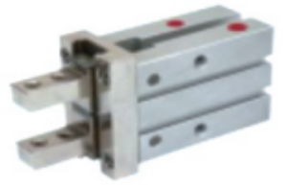
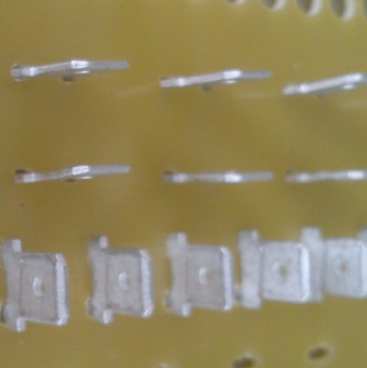
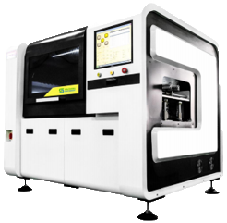
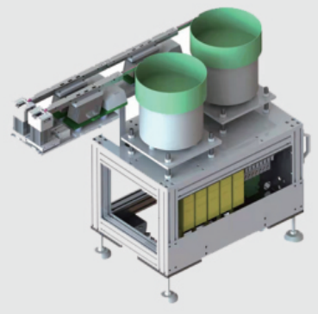
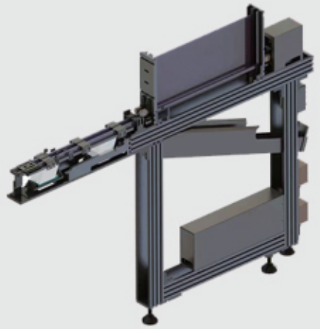
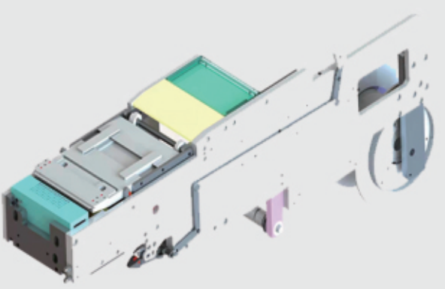
Souther Machinery 2023 Catalog
S7020
Component Range:
Electric Catch
Air Grab
Nozzle
Four heads design
Supports multiple grippers to grab multiple oddform components
Terminal
Eyelet
Pin
Tack Swich
Bowl feeder
Reel feeder
Reel feeder
Wide range of applications, can insert 4 kinds of oddfrom components at the same time.
Support various types of feeders, both bulk and braided components are available
Four heads design, extreme efficiency improvement
Dimension: 1400X1000X1600mm
PCB size: 350X300mm
Four heads design
Efficiency = 6500CPH(with Clinch) ≥ 7 workers
04
Video Link: https://youtu.be/KMk6hHi3V-8

Slide 6
Souther Machinery 2023 Catalog
S-600SV
Normal LED
Solutions
Auto mounting solution
S-530SV
Long board LED Solutions
S-V8
Lens Solutions
05

Slide 7
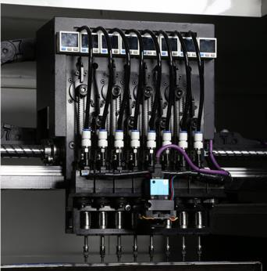
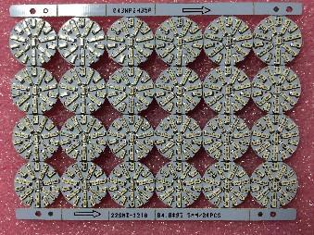
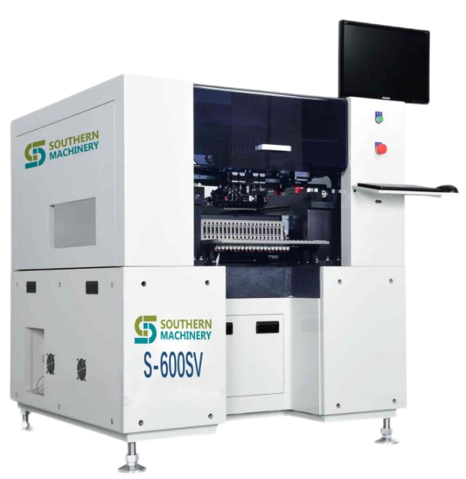
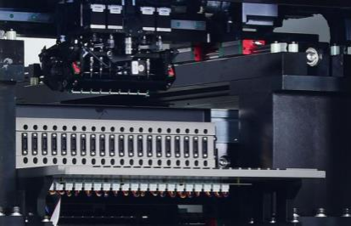
Souther Machinery 2023 Catalog
S-600SV
Component Range:
Eight heads design, extreme efficiency improvement
0603~5050~7474, high-power
LED, IC<10mm
Chip accuracy: ±0.05mm
Support 20 standard feeders, which can support the mount of 20 different components at the same time
Dimension: 1230X1200X1360mm
PCB size: 600X380mm
Eight heads design
Efficiency = 40000CPH ≥ 20 workers
06

Slide 8
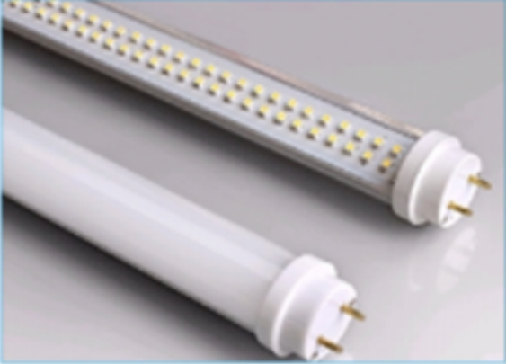
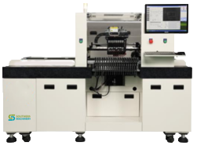
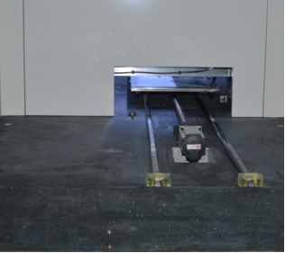
Souther Machinery 2023 Catalog
S-530SV
Eight heads design, extreme efficiency improvement
0603~5050~7474, high-power
LED, IC<10mm
Mechanical Precision: ±0.02mm
Zoom: ROI ≤ 6 Mons
Marble platform, can process long LED boards with a length of 1.5 meters
Dimension: 2000X1250X1400mm
PCB size: 1500X400mm
Eight heads design
LED Efficiency = 45000 CPH ≥ 23 workers
07

Slide 9
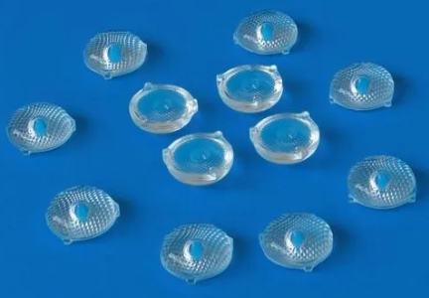
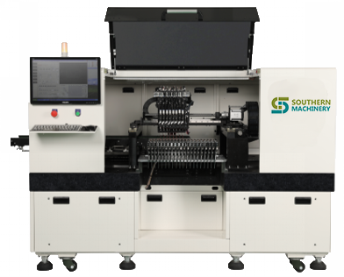
Souther Machinery 2023 Catalog
S-V8
Eight heads design, extreme efficiency improvement
Lens can be mounted
Highest precision
Placement accuracy: ±0.03mm
Stable placement of 0603 chips
Marble platform, can process long LED boards with a length of 1.2 meters
Dimension: 2000X1150X1400mm
PCB size: 1200X460mm
Eight heads design
LED Efficiency = 40000 CPH ≥ 20 workers
Lens Efficiency = 18000 CPH ≥ 15 workers
08

Slide 10
Souther Machinery 2023 Catalog
Standard production line
Solve standard production line problems
Production line peripheral equipment solutions
SMT production line
Solve SMT production line problems
THT production line
Solve THT production line problems
09

Slide 11
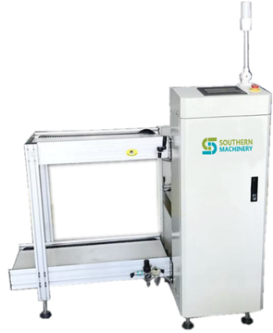
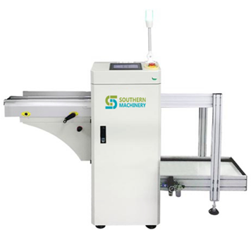
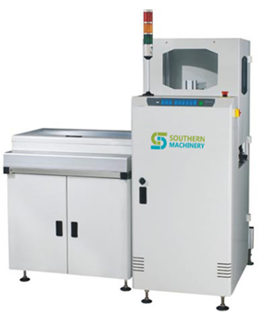
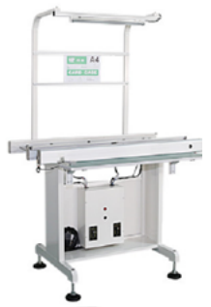
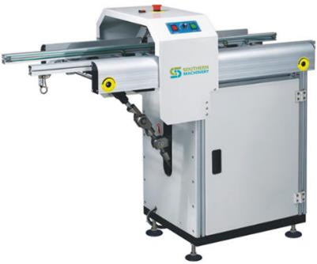
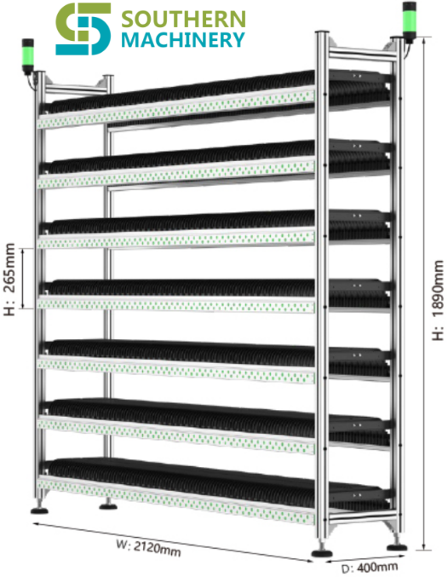
Souther Machinery 2023 Catalog
Standard production line
Loader
SLD390
1800*909*1250mm
This unit is used for loading of PCBs
Unoader
SULD390
2660*909*1250mm
This unit is used for unloading of PCBs
Buffer
SBM390
1550*1550*1205mm
This device used for receiving NG board or memory board
Conveyor
S-460D
500*786*900mm
This device is equivalent to SMD machine or operator testing station of PCBA equipment
Gate loader
SLC-400WN
1300*570*1050mm
This device is necessary for channel produchtion line
Intelligent reel rack
SIS7000A
2120*400*1890mm
This device is used for storage of 7" reels; 13",15" of model is SIS4000A.
*The above equipment can be customized
10
*Welcome to consult: jack@smthelp.com

Slide 12
Souther Machinery 2023 Catalog
Standard production line
Loader
SLD390
1800*909*1250mm
This unit is used for loading of PCBs
Unoader
SULD390
2660*909*1250mm
This unit is used for unloading of PCBs
Buffer
SBM390
1550*1550*1205mm
This device used for receiving NG board or memory board
Conveyor
S-460D
500*786*900mm
This device is equivalent to SMD machine or operator testing station of PCBA equipment
Gate loader
SLC-400WN
1300*570*1050mm
This device is necessary for channel produchtion line
Intelligent reel rack
SIS7000A
2120*400*1890mm
This device is used for storage of 7" reels; 13",15" of model is SIS4000A.
*The above equipment can be customized
11
*Welcome to consult: jack@smthelp.com

Slide 13
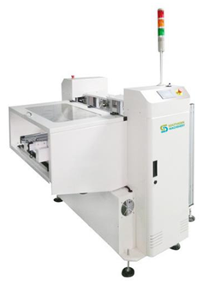
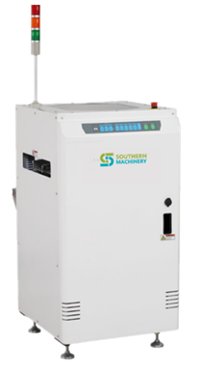
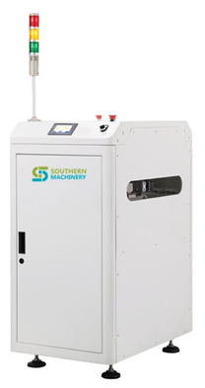
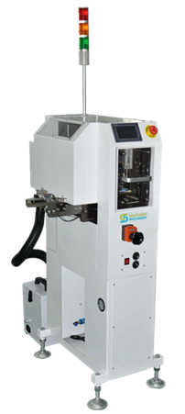
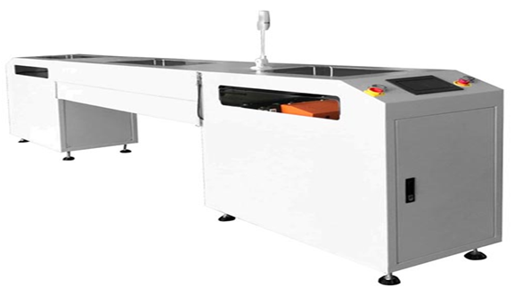
Souther Machinery 2023 Catalog
Standard production line
NG/OK unloader
SNL390
2160*1760*1250mm
This unit is used for automatic loading operation of double-sided boards and transceiver board
Inverter/Flipper
S-K390
550*780*1200mm
This unit is used to invert PCBs(180°) for ‘double-sided’ process
Turning Conveyor
SCN330
580*643*1200mm
This unit is used to redirect PCBs flow into different channels in a production line(90°，180°， 270°)
Cleaning Machine
SHQ460
500*700*1195mm
This machine is used into the remove the PCB surface dirty, elimanation of static electricity
Translational Conveyor
SPD460
600*W*1050mm
This unit is used to redirect PCBs flow into different channels in a production line
*The above equipment can be customized
12
*Welcome to consult: jack@smthelp.com

Slide 14
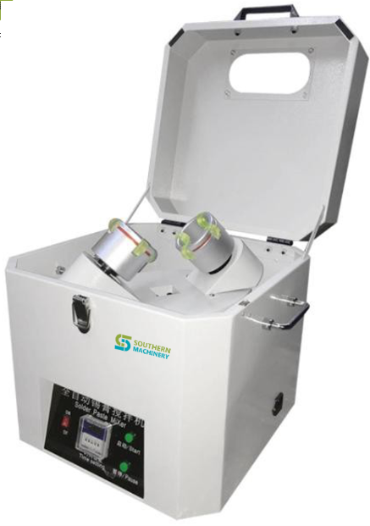
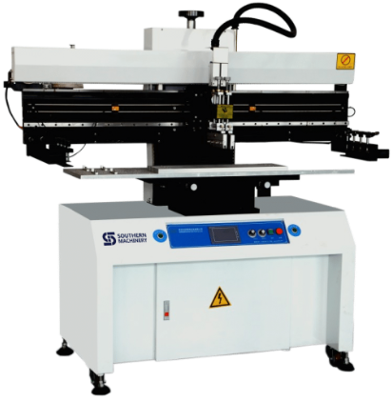
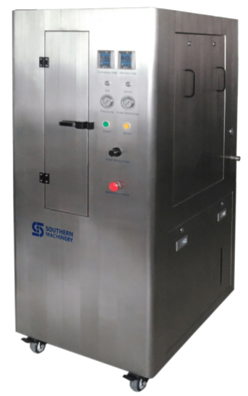
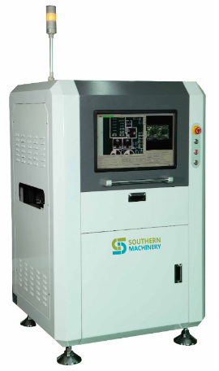
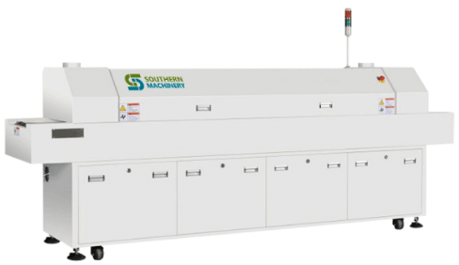
Souther Machinery 2023 Catalog
SMT production line
Solder Paste Mixer
S-SPM01
440*440*550mm
This devie is used to mix the solder paste
Semi-Auto Screen Printer
SP-1200
900*900*1650mm
This equipment is used to print solder paste on PCB
Stencil Clean Machine
S-1688
900*700*1730mm
This equipment is used to clean the stencil(750X736X40mm)
AOI
S-H680
980*960*1600mm
This equipment is used to detect common defects encountered in pcb (400*360mm)production
Reflow Oven
S-6600
3600*720*1250mm
This machine is used in reflow soldering process(6 temperature zone,other options are also available)
More model options for Reflow Oven and Screen Printer
13
*Welcome to consult: jack@smthelp.com

Slide 15
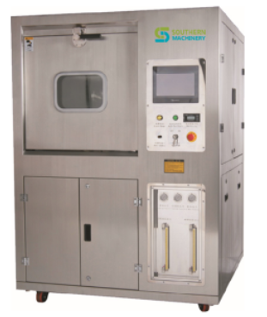
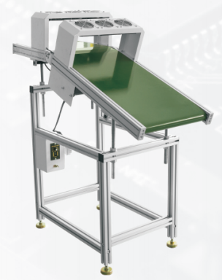
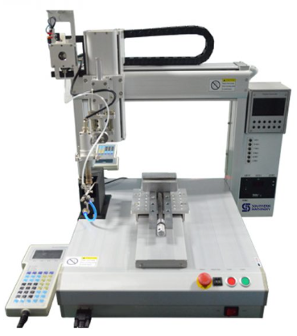
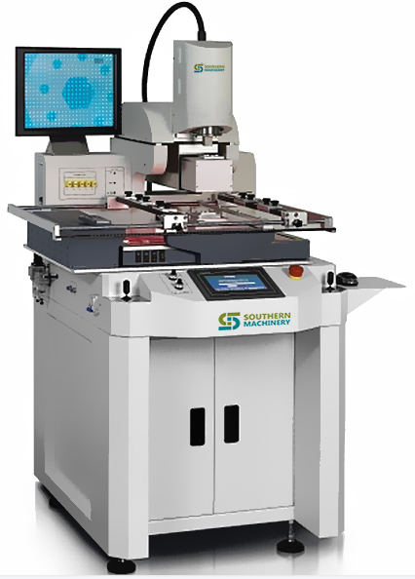
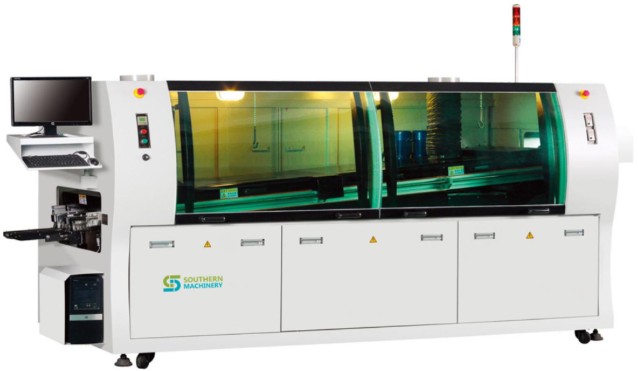
Souther Machinery 2023 Catalog
THT production line
PCBA Cleaning Machine
SME5600
1300*1200*1850mm
This machine is used to clean the PCB(560*550mm)
Solder unloader
S-UB460W
1200*730*1250mm
This unit is used to the transmission of the PCBs of Wave soldering inlet
Solder Robot
S-B400
650*600*720mm
This equipment is used for automatic soldering PCB(4 axis)
BGA Rework Station
SDS-900
970*700*1400mm
The equipment can be used for PCB repair (PCB size is 630*610mm)
Wave Soldering Machine
S-WS350B
3500*1400*1650mm
This machine is used for wave soldering process
More model options for the above machines
14
*Welcome to consult: jack@smthelp.com

Slide 16
Souther Machinery 2023 Catalog
Nozzle
Standard nozzle and custom nozzle
Accessories
Feeder
Standard feeder and custom feeder
Accessories required for machines on THT and SMT production lines
Other
15

Slide 17
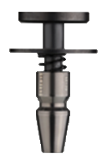
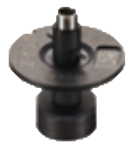
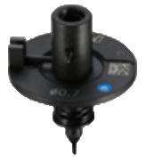
Souther Machinery 2023 Catalog
Nozzle
Custom Nozzle
Yamaha YG200
HA099
FUJI XP142/143
CN 110
FUJI NXT/H08M 0.7
FUJI NXT/H04 10.0
In addition to the above nozzles, there are more types of nozzles(customizable)
16
*Welcome to consult: jack@smthelp.com

Slide 18
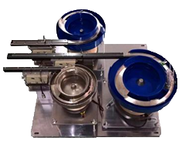
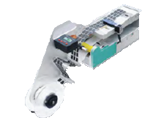
Souther Machinery 2023 Catalog
Feeder
Label Feeder
Vibration Feeder
Radial and Axial Feeder
Tube Feeder
Solder Feeder
In addition to the above feeders, there are more types of feeders(customizable)
17
*Welcome to consult: jack@smthelp.com

Slide 19
Souther Machinery 2023 Catalog
Other
Spare parts of machines on PCBA production line
Various facilities on the PCBA production line
Various consumables on PCBA production line
To know more information
18
*Welcome to consult: jack@smthelp.com

Slide 20
Souther Machinery 2023 Catalog
Services
Free proofing service;
Free technical consulting service;
Free customized solutions for customers;
Free freight guidance for customers;
Free after-sales service, including machine installation and machine training.
Notice: The above services are free
19
*Welcome to consult: jack@smthelp.com

Slide 21
Souther Machinery 2023 Catalog
About us
Pre-sale service
With more than 20 years of SMT experience, continuously improve product quality, product quality is outstanding
Has an independent manufacturing plant and design team, with independent production and research and development capabilities
We have cooperated with many high-quality customers, and the brand is trustworthy
20

Slide 22
WELCOME INQUIRY
Please visit
www.smthelp.com
Find us more
https://www.facebook.com/autoinsertion
Know more our team
https://cn.linkedin.com/in/smtsupplier
Welcome to our factory in Shenzhen China
See more machine working video, please Youtube
Auto Insertion
Google
Auto+insertion, to get more informations
Looking forward to your email
info@smthelp.com
21

